Slide 1
Electricity

Slide 2
By the end of this lesson you will be able to:
Describe the structure of an atom.
Explain how electrons can move between atoms.
Explain how electron movement can generate electricity.

Slide 3
Electricity is an incredibly important part of modern life.
If you look around you, you will probably see dozens of things which rely on electricity.
Everything from lightbulbs to cell phones to digital watches use electricity.

Slide 4
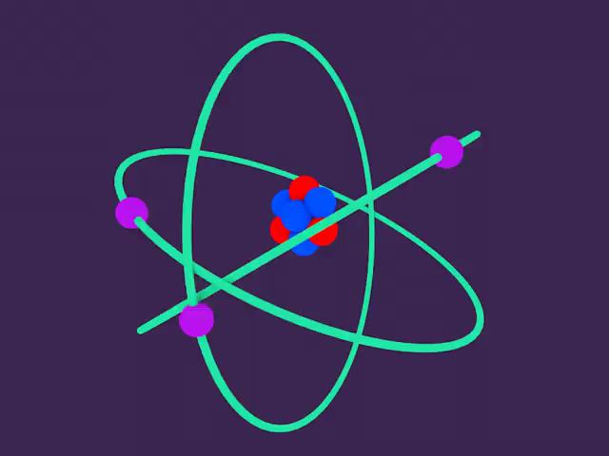
So what actually is electricity?
To understand what electricity is, we have to learn about atoms, the building blocks of life!
Atoms are too small to see even with the most powerful microscopes! But scientists are learning more about atoms and their subatomic particles every day!

Slide 5
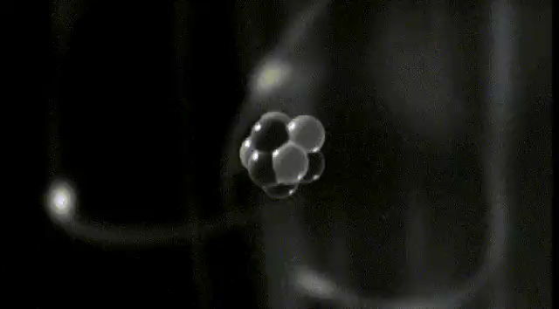
Atoms make up everything around us.
If you could zoom in really far to the desk in front of you, you would see it's made up of an uncountable number of atoms packed together.
But each atom is made up of even smaller particles, called subatomic particles. These are protons, neutrons and electrons.

Slide 6
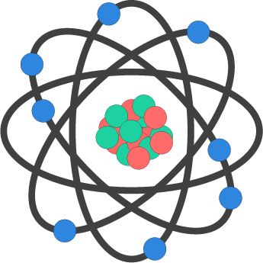
Atoms are made up of a central nucleus, with electrons around the outside.
The protons and neutrons are found in the centre of the atom inside the nucleus.
Electrons orbit around the outside of the nucleus. These subatomic particles all have a specific charge.

Slide 7
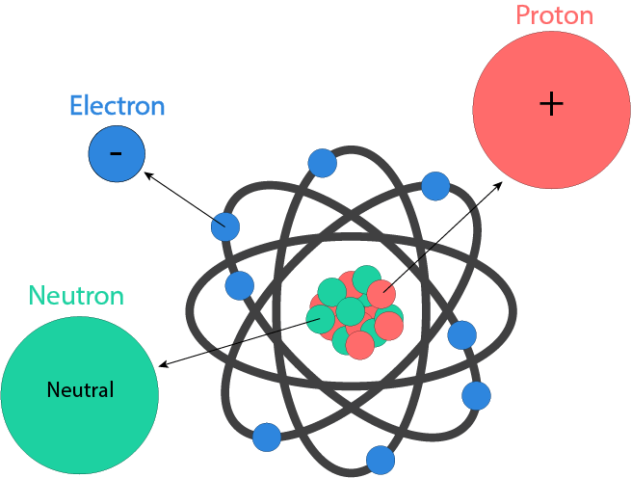
Electrons, protons and neutrons all have a specific charge.
Protons have a positive charge, and electrons have a negative charge. Usually, the number of electrons is equal to the number of protons in the atom.
Neutrons have no charge, or a neutral charge.

Slide 8
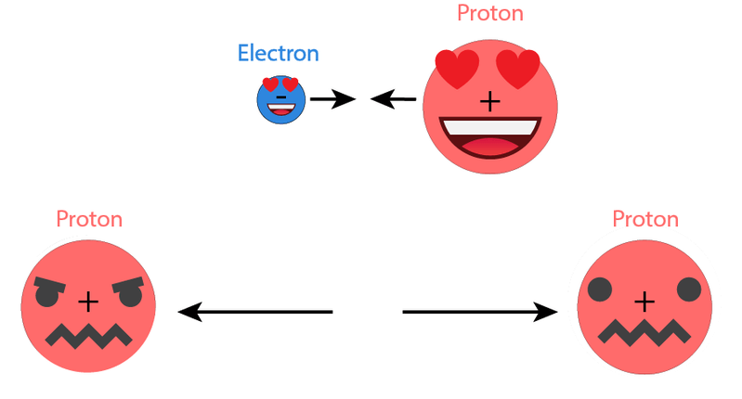
Depending on whether they are positive or negative, subatomic particles will either attract or repel each other.
Particles with the same charge will repel each other, and particles with opposite charges will attract each other!
This means that an electron will be attracted to a proton, but protons will be repelled away from other protons.

Slide 9
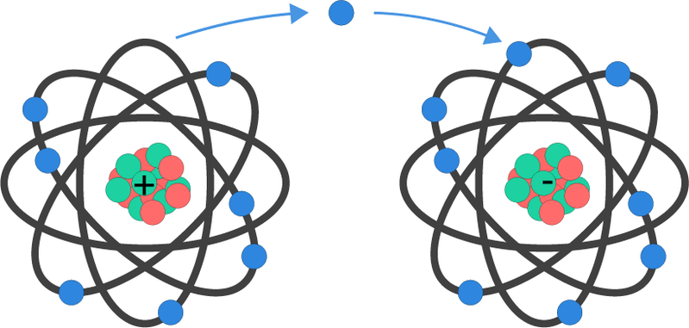
Electrons can move between atoms!
If enough electrostatic force is applied, an electron can escape its orbit around an atom. We call these free electrons and they can move and attach to other atoms.

Slide 10
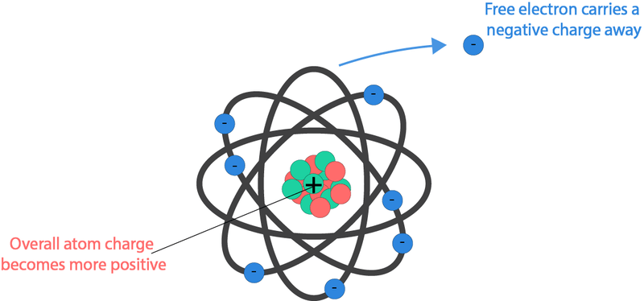
Usually the number of protons in an atom equals the number of electrons.
This is so the charge is balanced. When an electron becomes a free electron, it carries its negative charge with it.
This leaves the atom behind slightly more positive, and it means that a negative charge can be moved.

Slide 11

When an electron breaks free from an atom, it carries its negative charge with it.
Electricity is the flow of electrons, which is the flow of negative charge.

Slide 12
We can use a metal wire to carry a flow of electricity.
A metal wire is made up of lots of atoms. If an electron breaks free from an atom, it is attracted to other atoms around it and will attach itself to a new atom.
This atom then ejects one of its own electrons, which in turn looks for another atom nearby to attach to.

Slide 13
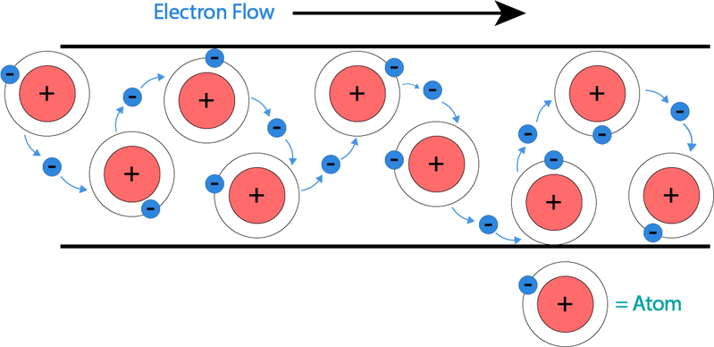
Whenever an electron breaks free, it looks for another atom to join on to.
This motion of electrons breaking free and moving to another atom creates a flow of electrons. This is electricity!
The electricity flows around a circuit a little bit like the flow of a river!

Slide 14
There are different types of electricity!
Static electricity is something you may experience as a small shock when you touch an object, such as a door handle. You are also watching static electricity at work when you see a lightning strike!
Static electricity is caused by a build up of charge, which is released when electrons are able to flow into another object.

Slide 15
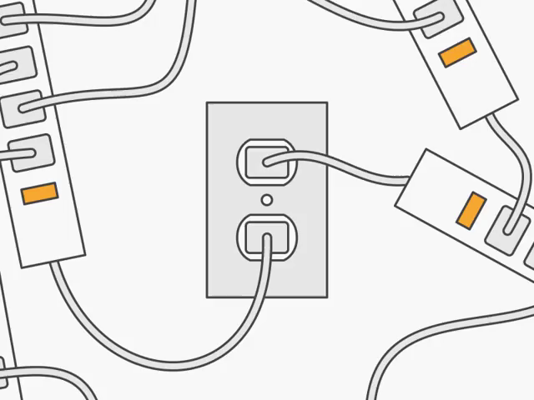
Static electricity is pretty cool, but we will be looking at current electricity throughout this topic.
Current electricity is the type of electricity that powers our society!
This form of electricity is created when there is a continuous flow of electrons.

